Slide 1
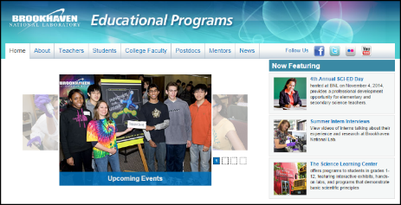
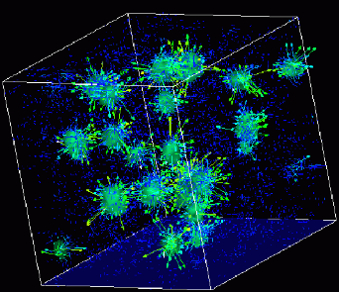
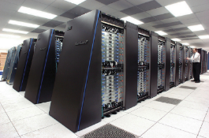
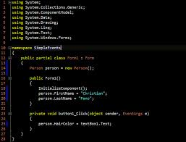
Advanced
Scientific Computing
(SciComp 201)
Session 26
Iterated Function Systems
<number>

Slide 2
Seminar Goals
Review 2D Affine Transformations
Rotation, Translation, Scaling, Reflection
Transformation Matrices
Understand Iterated Function Systems (IFS)
Mappings, Collage Theorem, & IFS Compression
<number>

Slide 3
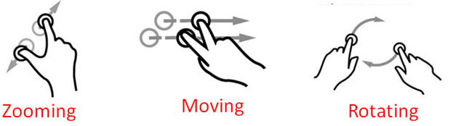
2D Affine Transformations
There are six possible transformations of an image
Scale (zoom, magnify, shrink)
Translate (move, slide, drag, push)
Rotate (turn, spin, twist)
Reflect (flip, invert, mirror)
Shear (stretch, squish, distort)
Identity (copy, no change, leave alone, skip)
Transformations # 1 - 3 are common touch screen operations
<number>

Slide 4
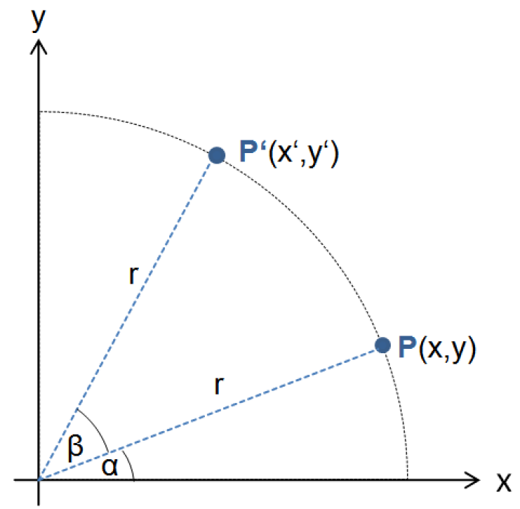
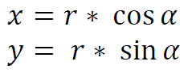
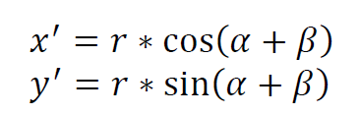
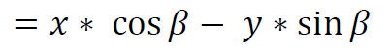
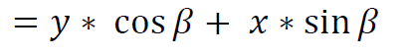
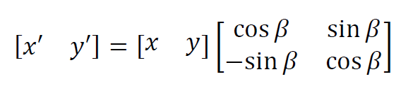
Rotation = Matrix Multiplication
<number>
Notes:
<number>

Slide 5
2D Affine Transformations
We use matrices to apply transformations to an image:
Represent each point to draw as a (1 x 3) matrix:
Multiply this point matrix by a (3 x 3) transformation matrix
The result of (1 x 3) (3 x 3) = (1 x 3) which is the new point!
Each transformation type has its own distinct 3 x 3 matrix
Successive transformations applied to the same point are formed by a sequence of matrix multiplications
<number>

Slide 6
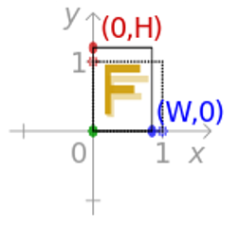
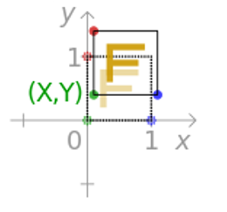
2D Affine Transformations
Scale
Translate
<number>
Notes:
<number>

Slide 7
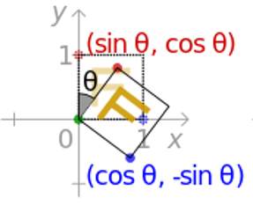
2D Affine Transformations
Rotate
<number>
Notes:
<number>

Slide 8
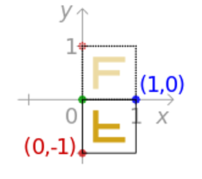
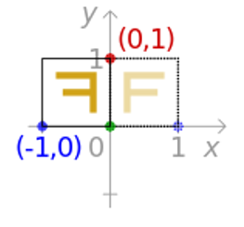
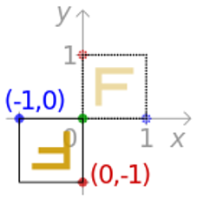
2D Affine Transformations
Reflect X
Reflect Y
Reflect XY
<number>
Notes:
<number>

Slide 9
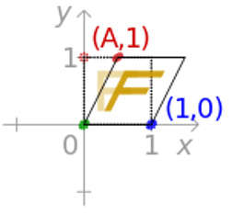
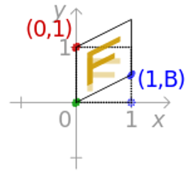
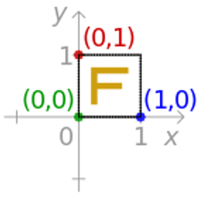
2D Affine Transformations
Shear X
Shear Y
Identity
<number>
Notes:
<number>

Slide 10
2D Affine Transformations
If we know the initial coordinates of a point, and we know the final coordinates of a point after a transformation is applied – how can we work backwards to generate the elements of the original transformation matrix?
We have seen that a transformation matrix is 3 x 3, but in reality it only has six unknowns because the last column is always set to (0, 0, 1) by definition
To determine all six unknowns of the transformation matrix, we need to know the before & after coordinates of three separate points → 3 pts x 2 coordinates = 6 knowns
We can solve a system of six equations with six unknowns
<number>
Notes:
<number>

Slide 11
2D Affine Transformations
are the initial points
are the final points
Two systems of 3 unknowns can solve for a … f
<number>
Notes:
<number>

Slide 12
2D Affine Transformations
It is because we need three distinct points to calculate a transformation matrix that not all possible transformations can be indicated with just two fingers on a touch screen
Two points only solves four unknowns – so we can’t represent reflections (flips, reverses, mirrors) with only two fingers – only moving, rotating, and zooming transformations
<number>
Notes:
<number>

Slide 13
A Single Transformation Mapping
Point # 3
Top Left
Dave
Dave
Point # 1
Bottom Left
The
Base Frame
Point # 2
Bottom Right
Every mapping requires 3 points!
<number>
Notes:
<number>

Slide 14
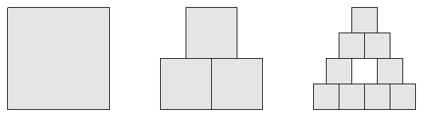
Multiple Transformation Mappings
(30, 30)
(0, 0)
The
Base Frame
<number>
Notes:
<number>

Slide 15
Multiple Transformation Mappings
(30, 30)
❸
(0, 15)
❶
❷
(0, 0)
(15, 0)
(0, 0)
Mapping #1
ifs.AddMapping(0, 0, 15, 0, 0, 15, Color.Blue);
<number>
Notes:
<number>

Slide 16
Multiple Transformation Mappings
(30, 30)
Mapping #2
ifs.AddMapping(15, 0, 30, 0, 15, 15, Color.Blue);
<number>
Notes:
<number>

Slide 17
Multiple Transformation Mappings
(30, 30)
Mapping #3
ifs.AddMapping(7.5, 15, 22.5, 15, 7.5, 30, Color.Blue);
<number>
Notes:
<number>

Slide 18
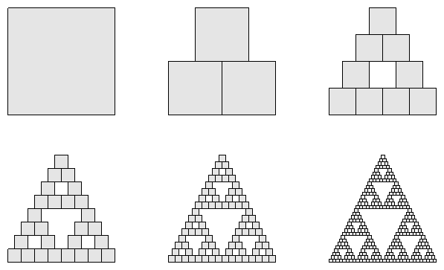
Strange Attractor of Iterated Mappings
Open and run Lab 1
<number>
Notes:
<number>

Slide 19
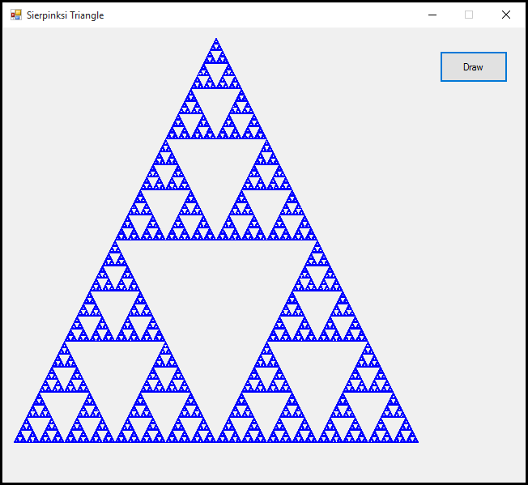
Lab 1 – Draw Triangle IFS
<number>
Notes:
<number>

Slide 20
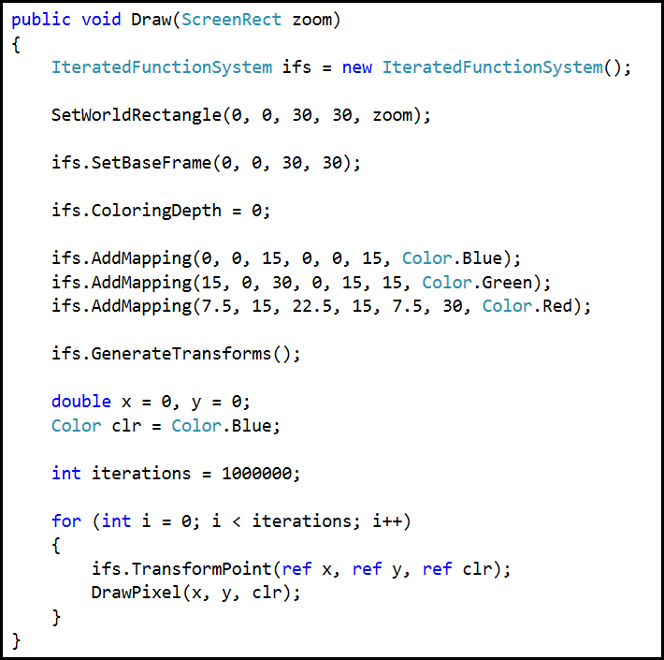
Lab 1 – Draw Triangle IFS
What happens when we change depth to 1 or 2?
<number>
Notes:
<number>

Slide 21
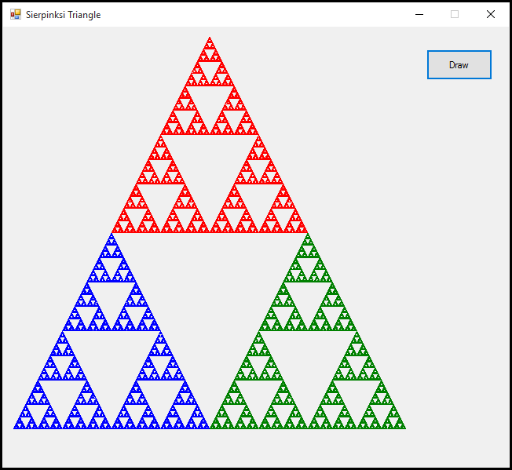
Lab 1 – Draw Triangle IFS
<number>
Notes:
<number>

Slide 22
From Mappings to a Transformation Matrix
So now we know a single mapping moves a set of three consistent initial points to three desired final locations
We also know that we need to specify three mappings to solve for the six unknowns in a transformation matrix
If we can solve those two systems of three unknowns, we can generate the transformation matrix that exactly produces those three mappings (solve for a .. f)
<number>
Notes:
<number>

Slide 23
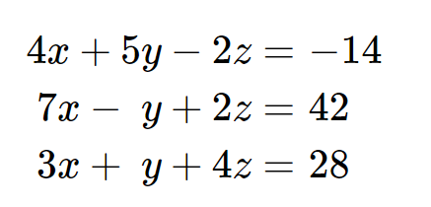
From Mappings to a Transformation Matrix
We know these values from our chosen mappings
Note this is the reverse problem from the 3 x 3 systems of equations we solved in a previous seminar
Back then we had the coefficients, but didn’t know the values
We used Cramer’s rule to determine the values
For the mappings, we know the values, but now we need to calculate the original coefficients
We don’t know these coefficients
<number>
Notes:
<number>

Slide 24
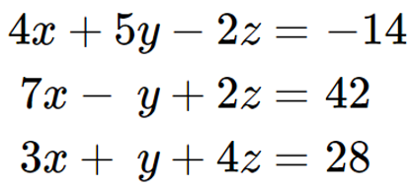
From Mappings to a Transformation Matrix
Since normal multiplication is commutative () we can treat the as if they were the coefficients, and solve for as if they were the values
We can therefore once again use Cramer’s rule to solve for the transformation matrix for a mapping of three points
Where xMin, yMin, xMax, yMax values come from the base frame!
<number>
Notes:
<number>

Slide 25
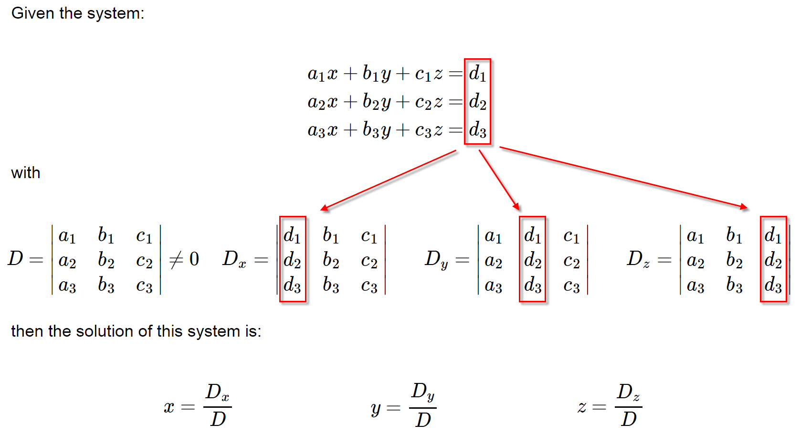
Cramer’s Rule
<number>

Slide 26
Iterated Function System
An IFS is a set of 2D affine transforms (linear equations)
During each iteration, the current pixel is colored
One of the transforms in the IFS is selected
That transform maps the current to
The point becomes the new and the process repeats
Each IFS transform has a probability
In some systems, every transform has equal probability of being chosen for the current iteration
In other systems, the probability is not uniform, and some transforms may be “favored” over others
<number>
Notes:
<number>

Slide 27
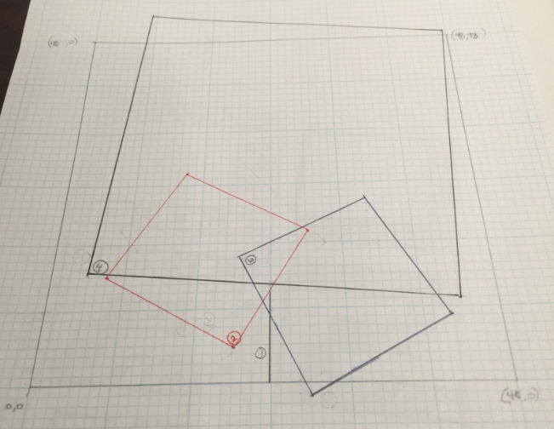
Iterated Function System
<number>
Notes:
<number>

Slide 28
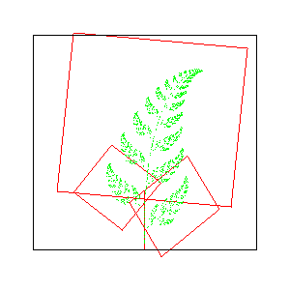
Iterated Function System
xMax, yMax
(0, 48)
(48, 48)
The
Base Frame
(0, 0)
(48, 0)
xMin, yMin
<number>
Notes:
<number>

Slide 29
Iterated Function System
Mapping #1
“Stem”
p = .01
<number>
Notes:
<number>

Slide 30
Iterated Function System
Mapping #2
“Left Leaf”
p = .07
<number>
Notes:
<number>

Slide 31
Iterated Function System
Mapping #3
“Right Leaf”
p = .07
<number>
Notes:
<number>

Slide 32
Iterated Function System
Mapping #4
“Next Frame”
p = .85
<number>
Notes:
<number>

Slide 33
Iterated Function System
Mapping #1
“Stem”
p = .01
Mapping #3
“Right Leaf”
p = .07
Open and run Lab 2
Mapping #2
“Left Leaf”
p = .07
Mapping #4
“Next Frame”
p = .85
<number>
Notes:
<number>

Slide 34
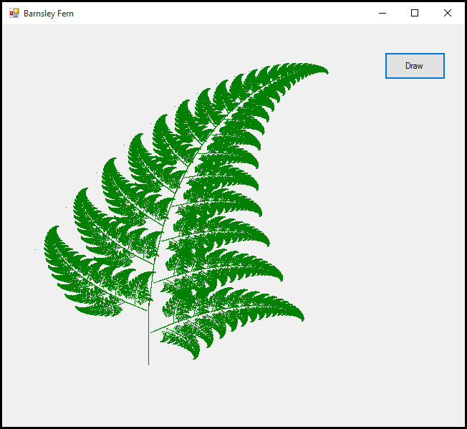
Lab 2 – Draw Fern IFS
<number>
Notes:
<number>

Slide 35
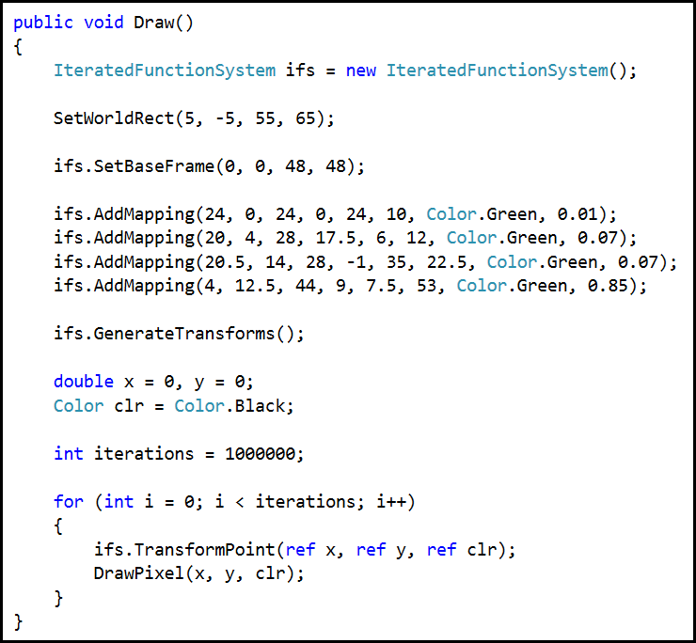
Lab 2 – Draw Fern IFS
Use a different color per transform – what happens to the strange attractor?
The probability of each transform being selected per iteration
<number>
Notes:
<number>

Slide 36
Lab 2 – Draw Fern IFS
Like with most dynamical systems, it does not matter what coordinates we pick for the - we will wind up with almost exactly same picture each run
Here is the even stranger thing:
It also does not matter what order we pick the transforms!
We can pick the transforms completely at random (but adhering to the occurrence probability ratios that are relative to each other) – and we will still get a similar image
Now “similar” is a relative term – but as far as humans are concerned, the images between two different IFS runs will appear almost the same no matter what PRNG seed we use!
The image we see is the strange attractor inherently locked inside the transformation matrices of the IFS!
<number>
Notes:
<number>

Slide 37
Lab 2 – Draw Fern IFS
Michael Barnsley discovered the IFS approach in 1988
Barnsley proved the “Collage Theorem” that shows:
If we chose a sufficiently dense set of affine transforms to appropriately “cover” or “map” the original image…
… and after we iterate that IFS a sufficient number of times…
… the original image will reappear – even though we regenerate it in a completely random order every time!
We have essentially encoded the original image into our system of linear equations!
The coefficients of the IFS (and their probability of selection) is the only the information we need to reproduce the original image – this enables higher compression that GIF, PNG, or JPEG!
<number>
Notes:
<number>

Slide 38
Lab 3 – Draw BNL IFS
The following IFS uses 29 affine transforms
The IFS was created by mapping a base frame into the various portions of the letters which makeup BNL
Some of the transforms rotate and skew the base frame, and you can see the affect of these transforms (and where they were originally targeted) within the letters themselves
Consider that an IFS is a fractal with no loss of detail throughout limitless zoom
Left click anywhere on the image to draw a zoom rectangle
Right click to return to prior zoom statee
<number>
Notes:
<number>

Slide 39
Lab 3 – Draw BNL IFS
❸
Open and run Lab 3
❶
❷
<number>
Notes:
<number>

Slide 40
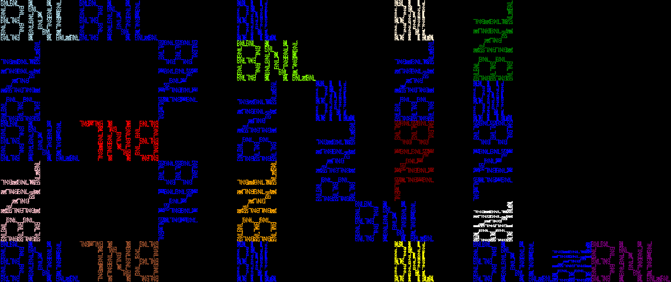
Lab 3 – Draw BNL IFS
<number>
Notes:
<number>

Slide 41
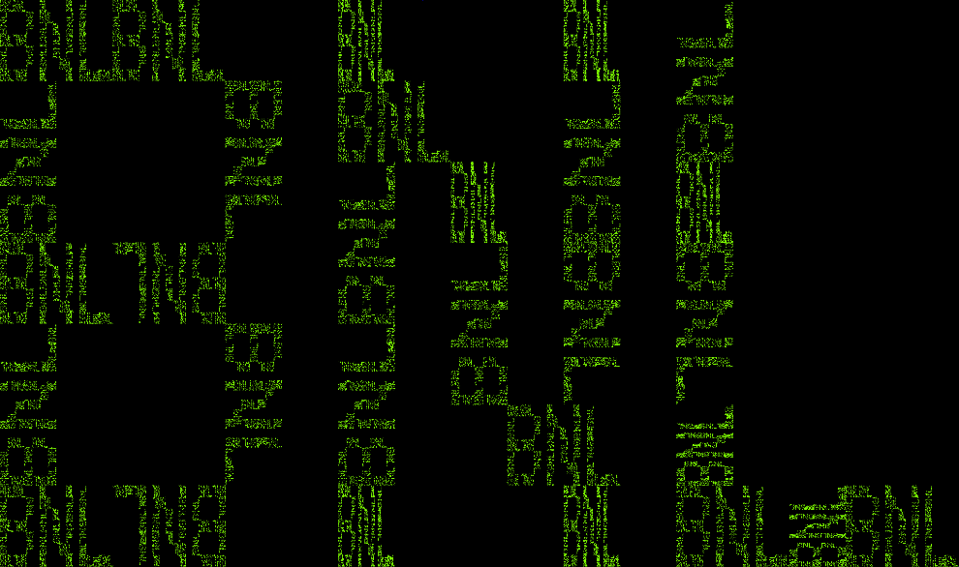
Lab 3 – Draw BNL IFS
This IFS is a 1.27D fractal that supports infinite self-similarity and limitless zoom
<number>
Notes:
<number>

Slide 42
Lab 3 – Draw BNL IFS
Size if saved as a JPG image: 70,900 bytes
Size if saved as an IFS: 444 bytes
Images transmitted via space satellites can be compressed over 95% when using an IFS
<number>
Notes:
<number>

Slide 43
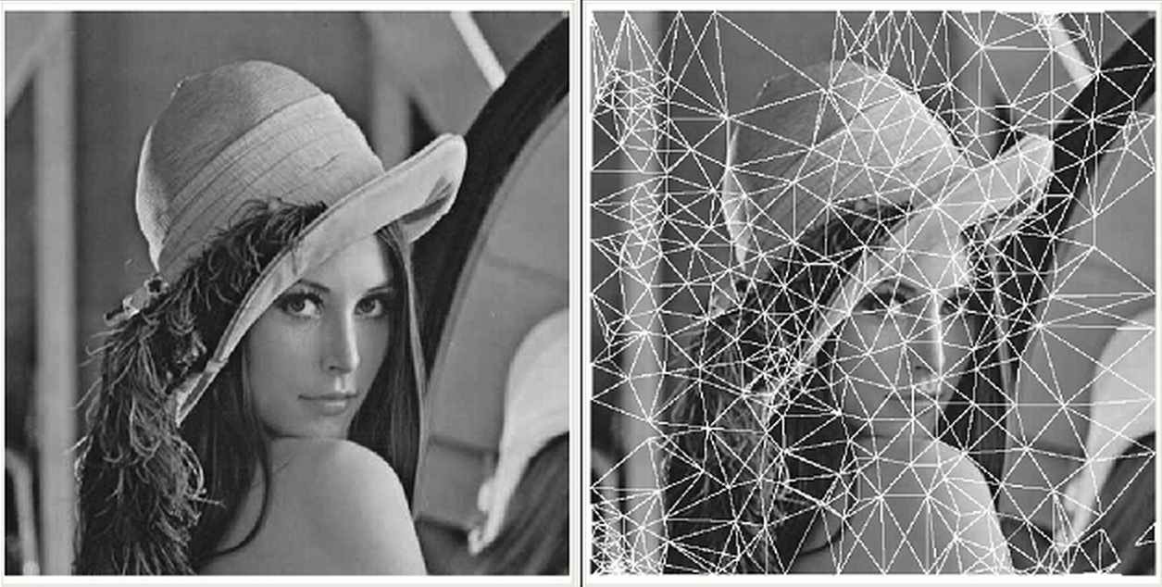
Fractal Image Compression
An IFS Encoder breaks images into transforms
having highest degree of self-similarity
<number>
Notes:
<number>

Slide 44
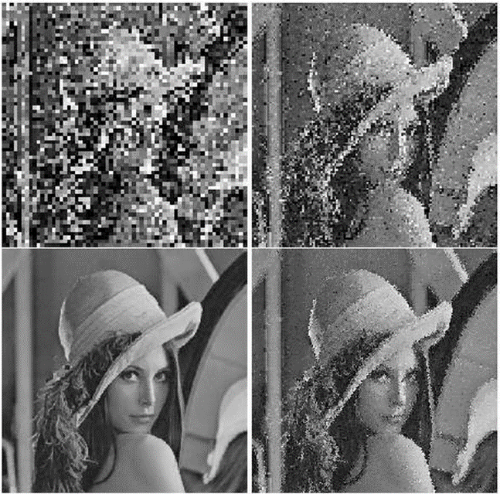
Fractal Image Compression
An IFS Decoder iterates the transforms
until reaching the desired level of detail
<number>
Notes:
<number>

Slide 45
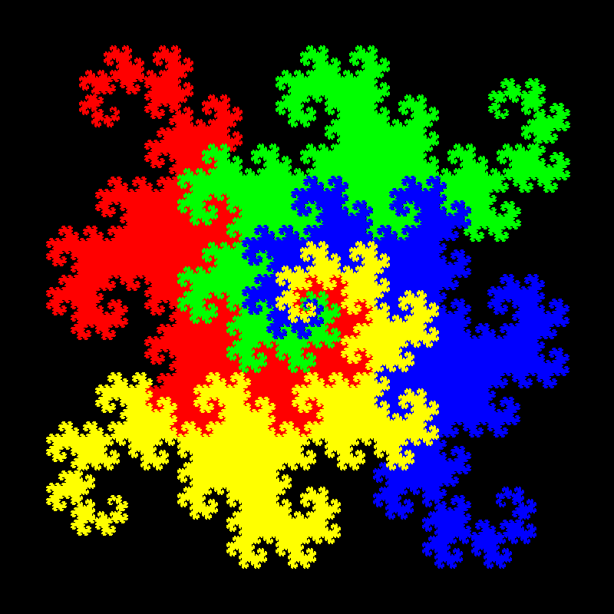
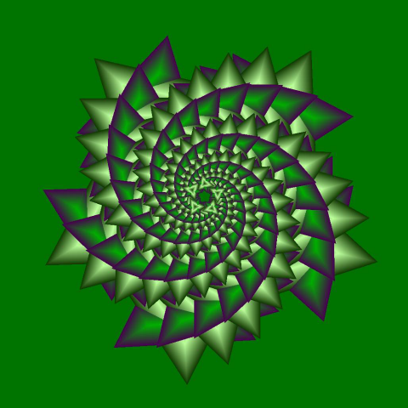
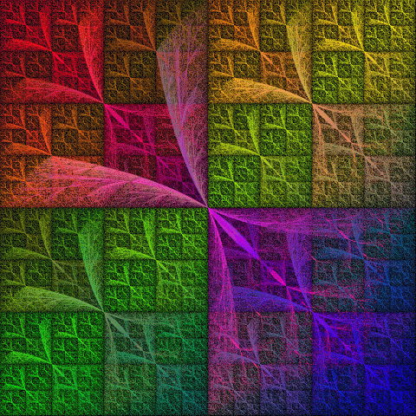
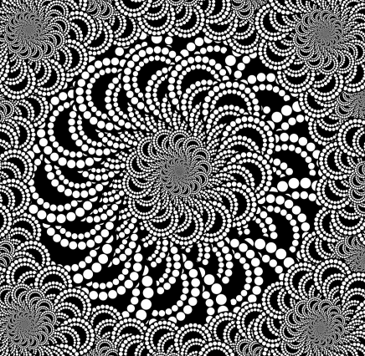
Fractal Guggenheim
<number>
Notes:
<number>

Slide 46
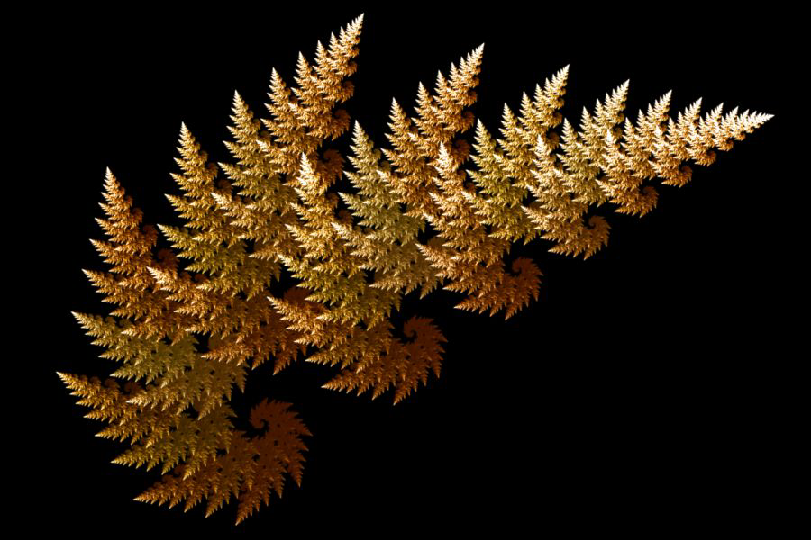
Fractal Guggenheim
<number>
Notes:
<number>

Slide 47
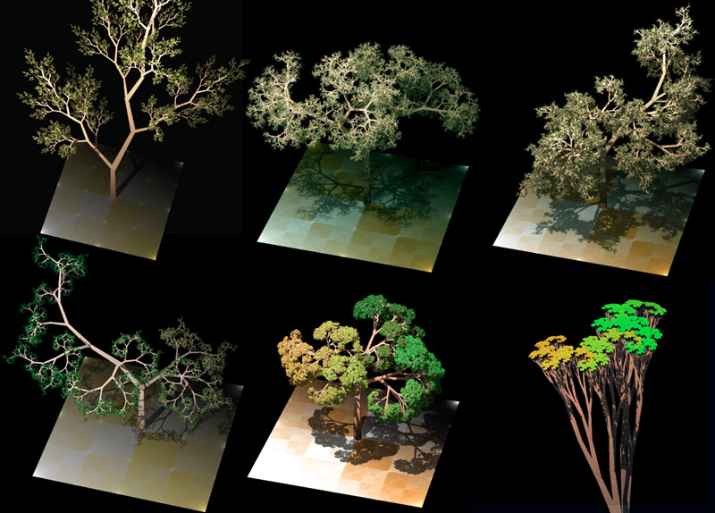
Fractal Guggenheim
<number>
Notes:
<number>

Slide 48

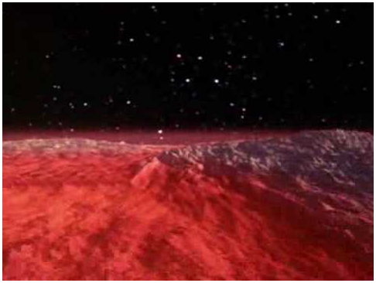
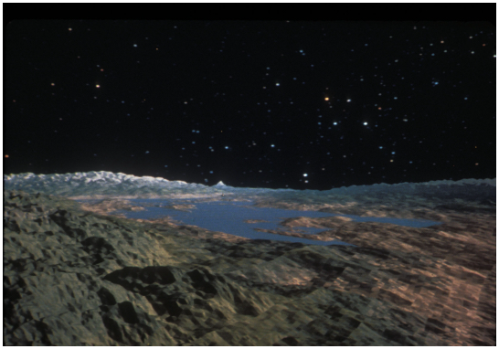
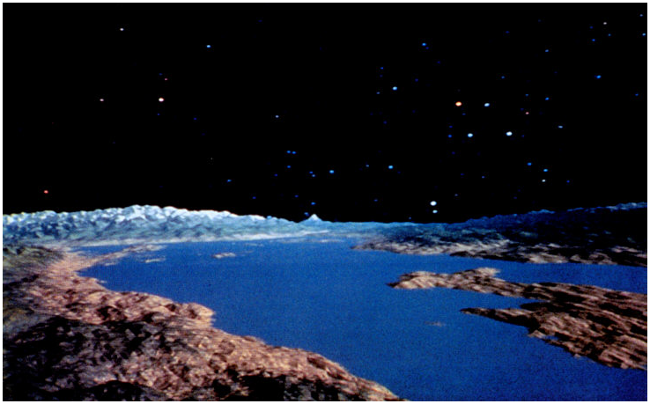
Fractal Guggenheim
1982 – Genesis Effect
<number>
Notes:
<number>

Slide 49
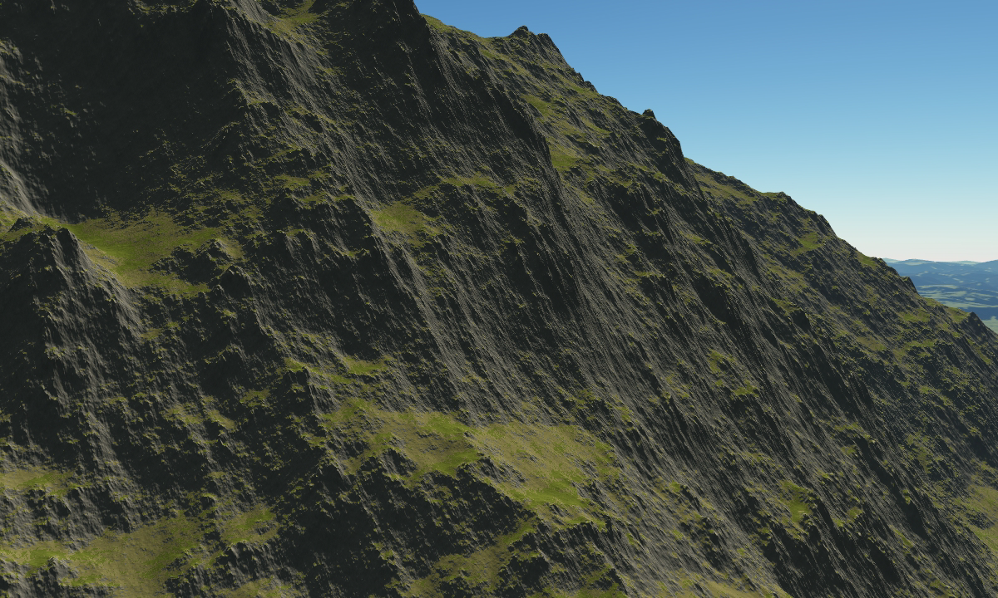
Fractal Guggenheim
<number>
Notes:
<number>

Slide 50

Fractal Guggenheim
<number>
Notes:
<number>

Slide 51
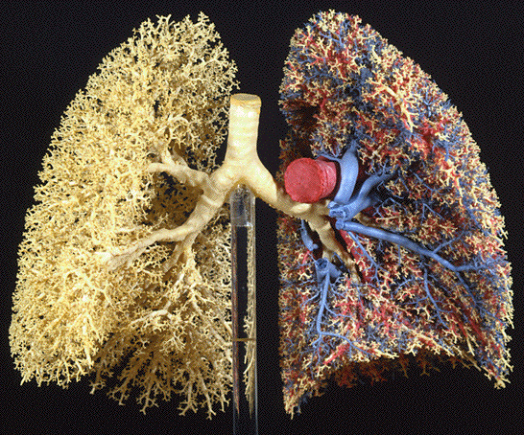
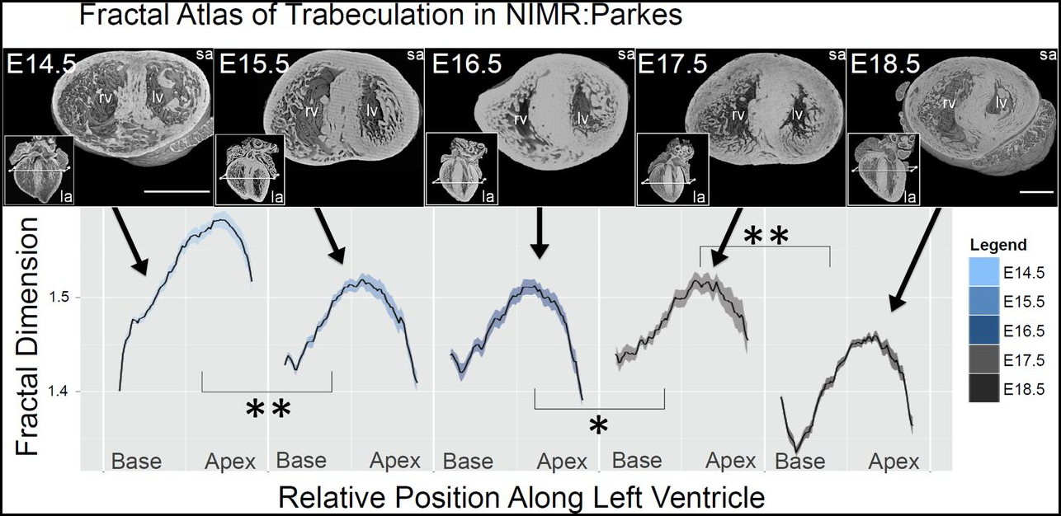
Fractal Modelling
<number>
Notes:
<number>

Slide 52
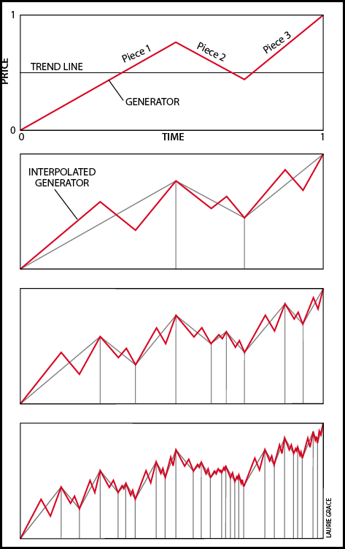

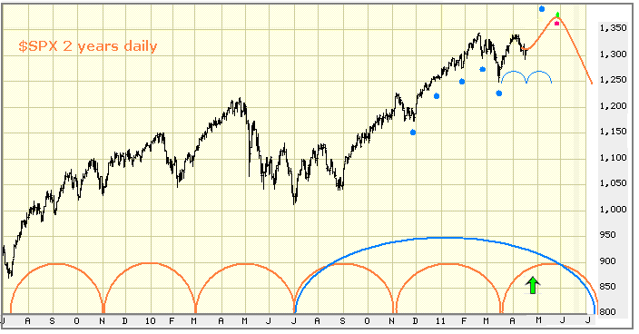
Fractal Modelling
<number>
Notes:
<number>

Slide 53


Lab 4 – Draw Square IFS
Add the remaining mappings to create this four colored square
(4, 4)
(0, 0)
<number>
Notes:
<number>

Slide 54

Lab 4 – Draw Square IFS
Add the remaining mappings to create this four colored square
(4, 4)
(0, 0)
<number>
Notes:
<number>

Slide 55
Now you know…
An Iterated Function System (IFS) is a set of 2D affine matrices that can rotate, flip, shear, transform images – mapping points from one iteration to the next
The Collage Theorem guarantees that if cover our original image with enough transforms, we will regenerate the original image after the IFS reaches a stable orbit
Appreciate the beauty buried within the coefficients of a simple set of linear equations - the entire Barnsley fern is encoded into just 24 numbers!
<number>
Notes:
<number>

